Slide 1
Real Life in a Public Relations Agency
Presented by bendure communications

Slide 3
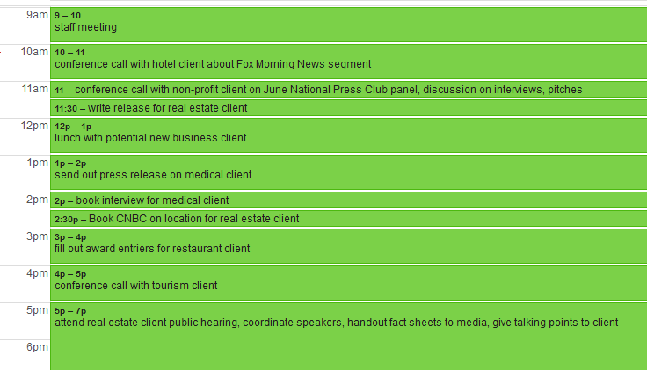
A Day in the life

Slide 4
Real Life in a Public Relations Firm
Long hours and hard work are key to success
Often switching from one topic to another
Opportunity to learn about and promote wide variety of topics
Opportunity to work as a creative team, generate and implement strategic and creative communications plans
Work on the “big idea”

Slide 5
PR Agency Structure
President/CEO/
General Manager
Vice President
Vice President
Director/Account Manager
Director/Account Manager
Sr. Account Executive
Sr. Account Executive
Sr. Account Executive
Account Executive
Account Executive
Account Executive
Account Assistant
Account Assistant

Slide 6
Public Relations Firm vs. In-house Corporate Communications
More reasonable hours in-house
In-house, there is less educational opportunity as you’ll only focus on one particular industry segment
Often more difficult to leverage for story placements in-house
No clients with in-house but will have to manage executives and employee expectations
If in-house, you develop a narrow skill set and focus

Slide 7
Big firms vs. small boutique firms
Advantages of a small firm
More autonomy
Opportunity to learn all aspects of a firm
Opportunity to work directly with clients
Easy path for growth and learning all aspects of the business
Big fish in a small pond

Slide 8
Big firms vs. small boutique firms
Advantages of a large firm
Opportunity not to have to deal directly with clients
More structure
Usually better salary, benefits
Support team
More people to learn from

Slide 9
Big firms vs. small boutique firms
Disadvantages of a small firm
Have to do more things yourself and make sure tasks are completed
Expected to oversee many tasks from start to finish
Salary may be lower than bigger firm and/or may have fewer benefits
May have to sign a non-compete agreement
If you don’t like your co-workers, you’re stuck

Slide 10
Big firms vs. small boutique firms
Disadvantages of a large firm
Small fish in a big pond– often overlooked for promotion
Less opportunity for learning and growth
More likely to have a rigid structure
Less opportunity to work on different kinds of projects/clients
Always concerned with ROI and account executives are expected to generate billable hours (expected to generate 3-4 times what their salary is)

Slide 11
Typical PR Firm Scenario
The client calls to complain about the account executive working on their account, you:
Tell the client you’ll change the team immediately
Tell the client that you’ll oversee the account
Tell the client that you’ll work with the account executive and make the necessary changes
Tell the client, “sorry, that’s who is working on your account.”

Slide 12
Typical PR Firm Scenario
The client is demanding way more of your time than they’ve contracted for. They’re a non-profit and are on a set PR budget so you know they can’t pay more. You:
Fire them so you can pay attention to your well-paying clients
Explain that their budget is too low to accomplish what they want
Explain that they need to stay within the plan and the hours

Slide 13
Fallout from prior scenario
Client has unrealistic expectations and doesn’t understand what the deliverables should be.
Client leaves and goes to another PR firm.
Client changes their internal team to align with agency needs.
Agency works closer with client in helping them understand and have realistic expectations.

Slide 14
Typical PR Scenario
Big National Client Goes to Big National Firm
Fees are extremely high
Client finds themselves working with someone just out of college
As account grows and client asks for a few more things, account executive constantly warns that they cannot deliver extras without more money
This attitude irritates client (spending in excess of $500K per year on account)
National client leaves big firm and goes to small firm which delivers more customer service and is very appreciative

Slide 15
Typical PR Scenario
Big National Client Goes to Small PR Firm
Client is very pleased with small firm
As client and account grow, small firm is unable to deliver on expanded duties so the firm sub-contracts to lobbying firm, web firm, social media firm; monopolizes firm’s time and resources
Client cuts retainer
Small firm suddenly goes out of business

